Slide 1
CHAPTER 1: MECHANICS Overview
Displacement and First, second and third order time-derivatives of displacement.
Concept of generalised coordinates.
Inertial mass, moment of inertia, force, torque.
Equilibrium and principle of virtual work.
2D Motion in a gravitational field.
Conservative and non-conservative force-fields.
Conservation of momentum.
Elastic and inelastic collisions and Energy loss and deformation in inelastic collisions.
Energy absorbed in material fracture.
Applications to packaging, protection and inspection of equipment

Slide 2
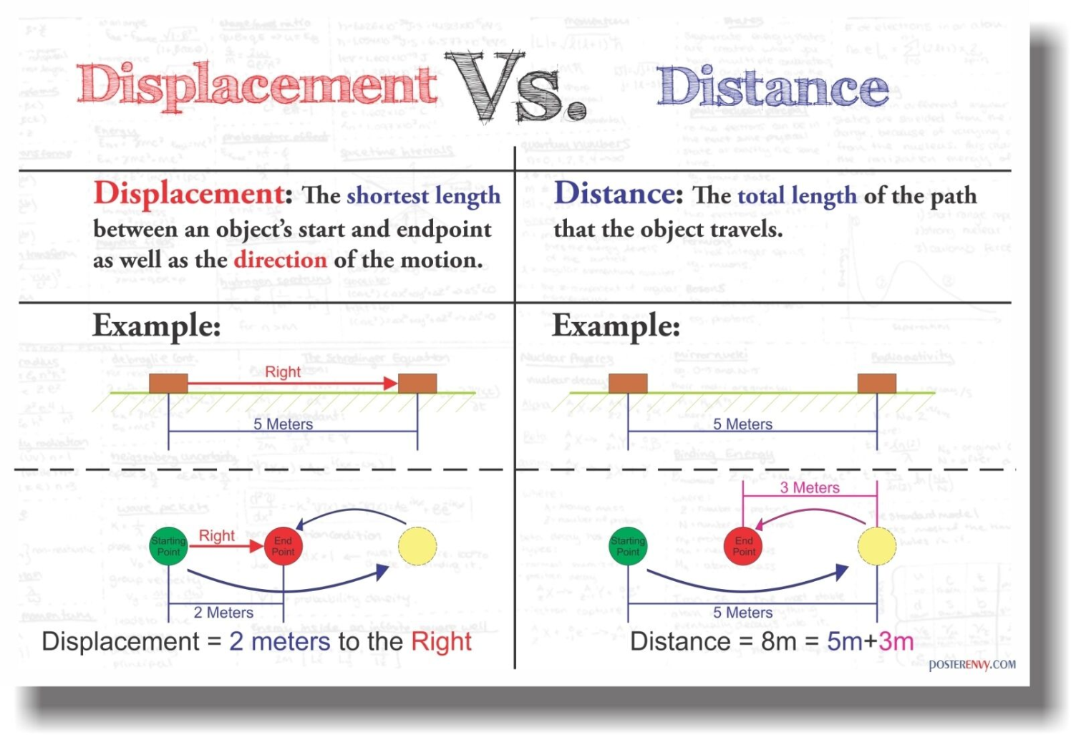
DISPLACEMENT AND ITS DERIVATIVES
? Displacement
Displacement is the vector that specifies the change in position of a point, particle, or object.
The position vector directs from the reference point to the present position.

Slide 3
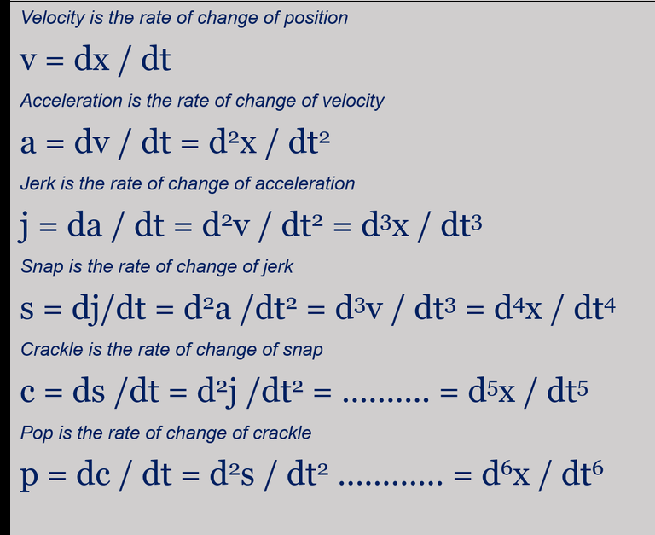
It’s derivatives............

Slide 4
Positive displacement, positive velocity and positive acceleration

Slide 5
Time (s) Displacement(cm)
0 0
1 0.5
2 1.5
3 3
4 5
5 7.5
6 10.5
Time (s) Acceleration(cm/s² )
2 0.5
3 0.5
4 0.5
5 0.5
6 0.5
Time Velocity(cm/s)
0 0
1 0.5
2 1
3 1.5
4 2
5 2.5
6 3

Slide 6
Time (s) Displacement (cm)
0 0
1 0.5
2 1.3
3 3
4 4.9
5 7.6
6 10.9
Time (s) Acceleration(cm/s²)
2 0.3
3 0.9
4 0.2
5 0.8
6 0.6
Time (s) Velocity (cm/s)
0 0
1 0.5
2 0.8
3 1.7
4 1.9
5 2.7
6 3.3

Slide 7
Positive displacement, positive velocity and negative acceleration
Time (s) Displacement (cm)
0 0
1 3.5
2 6.5
3 9
4 11
5 12.5
6 13.5
7 14

Slide 8
Time (s) Velocity (cm/s)
0 0
1 3.5
2 3
3 2.5
4 2
5 1.5
6 1
7 0.5
Time (s) Acceleration (cm/s²)
2 -0.5
3 -0.5
4 -0.5
5 -0.5
6 -0.5
7 -0.5

Slide 9
Time (s) Displacement(cm)
0 0
1 0.5
2 1.5
3 3
4 5
5 7.5
6 10.5
7 7.5
8 5
9 3
10 1.5
11 0.5
12 0

Slide 10
Time (s) Velocity (cm/s)
0 0
1 0.5
2 1
3 1.5
4 2
5 2.5
6 3
7 -2.5
8 -2
9 -1.5
10 -1
11 -0.5
12 -0
Time(s) Acceleration(cm/s²)
2 0.5
3 0.5
4 0.5
5 0.5
6 0.5
7 0.5
8 0.5
9 0.5
10 0.5
11 0.5

Slide 11
Time (s) Displacement (cm)
0 0
1 0.5
2 1.5
3 3
4 5
5 7.5
6 10.5
7 13.5
8 16
9 18
10 19.5
11 20
12 20.5

Slide 12
Time (s) velocity (cm/s)
0 0
1 0.5
2 1
3 1.5
4 2
5 2.5
6 3
7 3
8 2.5
9 2
10 1.5
11 1
12 0.5
13 0
Time (s) Acceleration (cm/s²)
1 0.5
2 0.5
3 0.5
4 0.5
5 0.5
6 0.5
7 0
8 -0.5
9 -0.5
10 -0.5
11 -0.5
12 -0.5

Slide 13
Time (s) Displacement(cm)
0 0
1 0.5
2 1.5
3 3
4 5
5 7.5
6 10.5
7 7.5
8 5
9 3
10 1.5
11 0.5
12 0

Slide 14
Time (s) Velocity (cm/s)
0 0
1 0.5
2 1
3 1.5
4 2
5 2.5
6 3
7 -2.5
8 -2
9 -1.5
10 -1
11 -0.5
12 -0
Time(s) Acceleration(cm/s²)
2 0.5
3 0.5
4 0.5
5 0.5
6 0.5
7 0.5
8 0.5
9 0.5
10 0.5
11 0.5

Slide 15
Negative velocity and negative acceleration

Slide 16
Negative velocity and positive acceleration

Slide 17
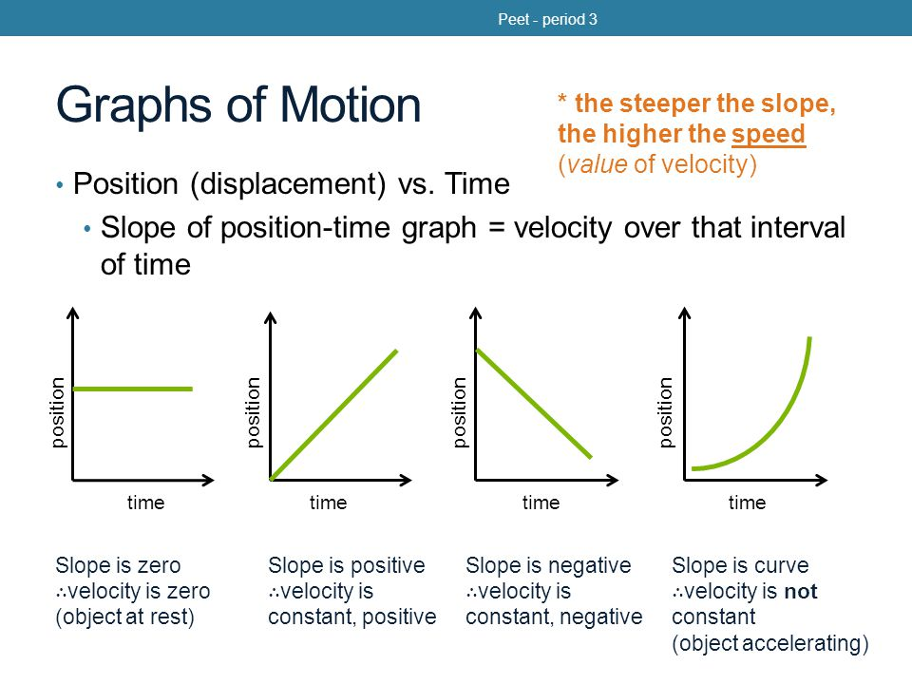
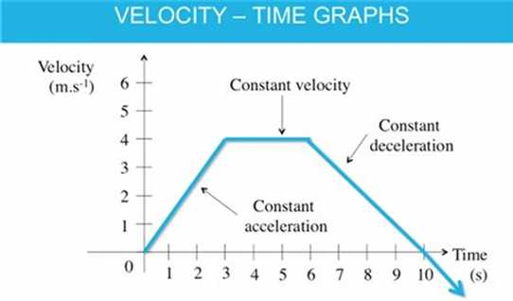

Slide 18
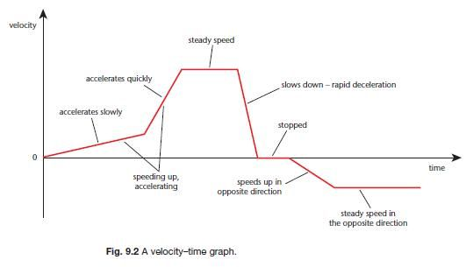
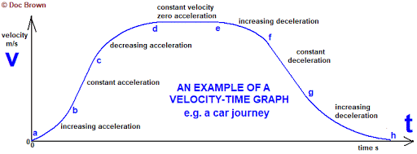

Slide 19
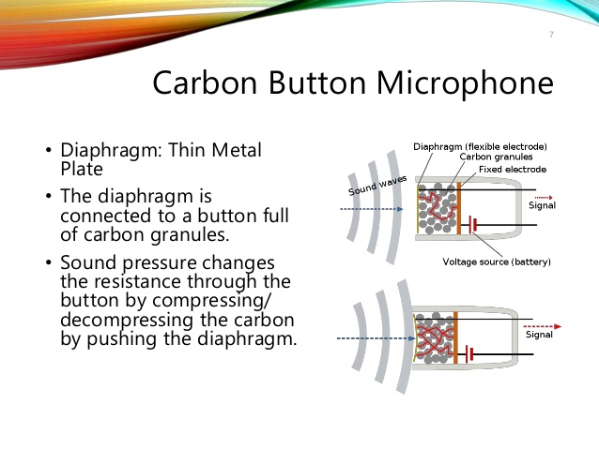
Where are all these terms applied?
A displacement sensor
Wave:
Disturbance
What?
Periodic

Slide 20

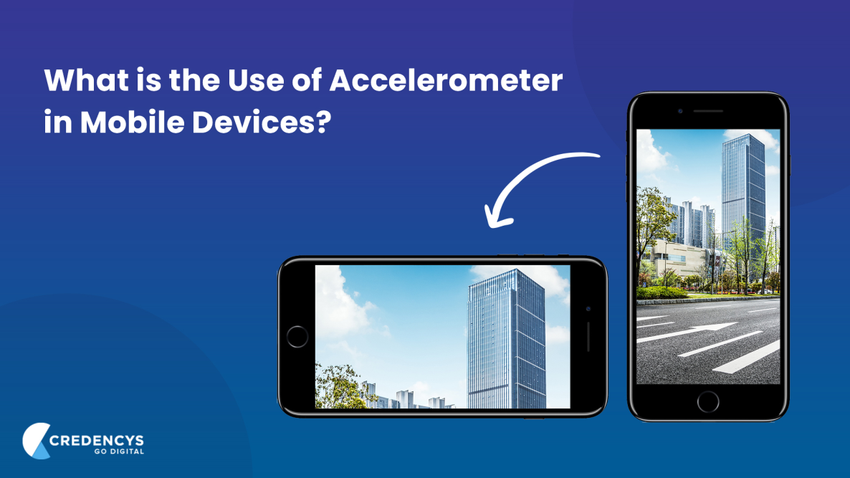
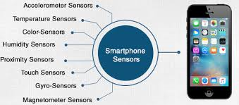
Velocity sensitive piano style key board :
A note is made louder by hitting a key faster
An accelerometer is a tool that measures proper acceleration. Proper acceleration is the acceleration of a body in its own instantaneous rest frame; this is different from coordinate acceleration, which is acceleration in a fixed coordinate system

Slide 21
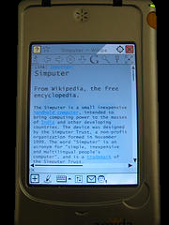
The AmidaSimputer, a handheld Linux device launched in 2004, was the first commercial handheld to have a built-in accelerometer. It incorporated many gesture-based interactions using this accelerometer, including page-turning, zoom-in and zoom-out of images, change of portrait to landscape mode, and many simple gesture-based games.
The word "Simputer" is an acronym for "simple, inexpensive and multilingual people's computer",

Slide 22
Here is the story of jerk :
A number of years ago, engineers at General Motors were trying to find the analytical foundations for what passengers considered a comfortable ride in a vehicle. They assumed that minimizing vertical acceleration was the key, but road testing said otherwise. They found that the rate of change of acceleration, or the third derivative of position, was the key factor. This was new mathematical ground, and GM didn't know what to call the derivative of acceleration. Finally, someone suggested the term "jerk," and that is what stuck, at least for a while.
As its name suggests, jerk is important when evaluating the destructive effect of motion on a mechanism, or the discomfort caused to passengers in a vehicle.
When designing a train, the engineers will typically be required to keep the jerk less than 2 metres per second cubed for passenger comfort.
In the aerospace industry they even have such a thing as a jerkmeter: an instrument for measuring jerk.
The movement of delicate instruments needs to be kept within specified limits of both acceleration and jerk to avoid damage.

Slide 23
Just to appreciate the importance of acceleration and jerk , here is a small video for you’ll
https://youtu.be/DMKcO-T5Y4o

Slide 24
References:
Steve Mann, Ryan Janzen, Mark Post (2006), "Hydraulophone Design Considerations: Absement, Displacement, and Velocity-Sensitive Music Keyboard in which Each Key is a Water Jet." ACM Multimedia (MM 2006), pp. 519-528, Santa Barbara, CA, Oct. 23-27, 2006. ([1])
Steve Mann, Michael Georgas, Ryan Janzen (2006), "Water jets as pixels: water fountains as both sensors and displays", Eighth IEEE International Symposium on Multimedia, IEEE ISM2006, pp. 766-772, Dec. 11-13, 2006, San Diego, CA.
Steve Mann, Ryan Janzen, Raymond Lo, Chris Aimone (2007), "Inventing new instruments based on a computational "hack" to make a badly tuned or unpitched instrument play in perfect harmony", International Computer Music Conference, ICMC2007, Aug. 27-31, 2007, Copenhagen, Denmark.
http://math.ucr.edu/home/baez/physics/General/jerk.html
https://www.machinedesign.com/archive/article/21817072/the-third-derivative-of-position-is-jerk
https://www.researchgate.net/publication/264232855_Sensitivity_of_
Tri-Axial_Accelerometers_within_Mobile_Consumer_Electronic_Devices_A_Pilot_Study
https://www.khanacademy.org/science/physics/one-dimensional-motion/acceleration-tutorial/a/what-are-acceleration-vs-time-graphs

Slide 25
Equations of Motion These equations can only be applied when acceleration of a body is constant and motion is linear
v = u + at
v² = u² + 2as
s = ut + ½at²
where,
s = displacement;
u = initial velocity;
v = final velocity;
a = acceleration; t = time of motion

Slide 26
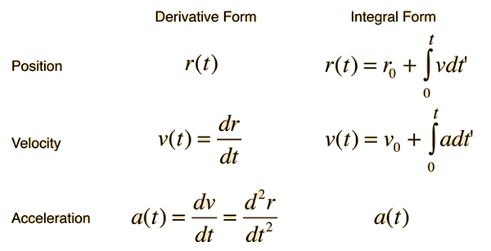
Time Dependent Acceleration
If the acceleration of an object is time dependent, then calculus methods are required for motion analysis. The relationships between position, velocity and acceleration can be expressed in terms of derivatives or integrals.
The first derivative of a point is the slope of the tangent line at that point. When the slope of the tangent line is 0, the point is either a local minimum or a local maximum. Thus when the first derivative of a point is 0, the point is the location of a local minimum or maximum.

Slide 27
A Car with an initial speed of 1 m/sec was in motion for 10 minutes, and then it came to a stop, the velocity right before it stopped was 5 m/sec. What was the constant acceleration of the car?
Initial Velocity= 1 m/sec
Final Velocity= 5 m/sec
Time for which the car was in motion = 10 min
Acceleration = ?
v = u+ at
5 = 1+ a× (10×60)
a × 600 = 4
a = 4/600
a = 0.0066 m/sec²

Slide 28
A cycle covered 2 km in 8 minutes and the initial velocity of the cycle was 1 m/sec. Find the acceleration that the cycle had in its motion.
Displacement covered= 2km
Total Time Taken = 8minutes= 8× 60= 480 s
Initial Velocity= 1 m/s
Equation of motion, S= ut + 1/2(at²)
2000= 1× 480 + 1/2(a×480²)
2000= 480+ 115200a
1520= 115200a

Slide 29
A toy is accidentally dropped by a kid from his roof. The final velocity of the toy before it reached the ground was 8m/sec. Find the height of the building.
Acceleration of the toy is equal to the acceleration due to gravity.
a = g = 9.8m/s²
Final velocity= 8m/s
Initial velocity= 0m/s
v²= u²+ 2aS
8² = 0+ 2×9.8 × S
S = 64/(9.8×2)
S = 3.26 meters
Hence, the height of the building is 3.26 meters.

Slide 30
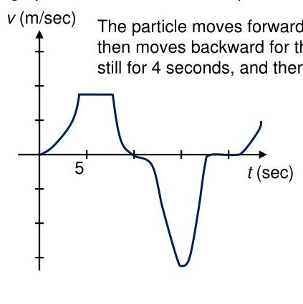
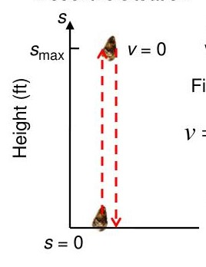
Questions to ponder:
1. A particle moves along an axis, and its velocity is shown in the graph below. When does the particle have maximum speed ? Also trace the movement of the particle
2. A dynamite blast propels a heavy rock straight up with a launch velocity of 160 ft/s. It reaches a height of S = 160t – 16t² after t seconds. (a) How high does the rock go?(b) What is the acceleration of the rock at any time t during its flight?

Slide 31
If a particle is moving in space with a velocity function v(t) = t²-2t-8
At what time if any is particle is at rest
What is the acceleration at time t = 3 s
A soccer ball is kicked into the air so that the path of flight can be
modelled by the function, x(t) = -4.9t²+9.8t+5
At what time will the ball land?
How many meters above the ground was the ball kicked initially
What is the maximum height the ball will reach and at what time it occurs?
What is the acceleration of the ball at 0.8 s and 2 s

Slide 32
3. A confident race car driver is cruising at a constant velocity of 20 m/s. As she nears the finish line, the race car driver starts to accelerate. The graph shown below gives the acceleration of the race car as it starts to speed up. Assume the race car had a velocity of 20 m/s at time t=0s. What is the velocity of the race car after the 8 seconds of acceleration shown in the graph?
a (m/s² )
6
8
t (s)

Slide 33
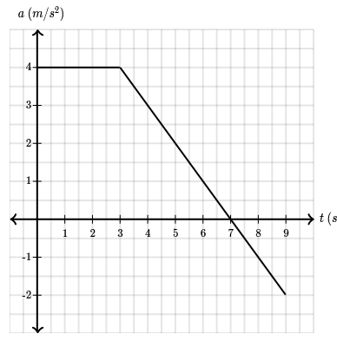
A sailboat is sailing in a straight line with a velocity of 10 m/s. Then at time t=0s, a stiff wind blows causing the sailboat to accelerate as seen in the diagram below.
What is the velocity of the sailboat after the wind has blown for 9 seconds?
Answer:
The final velocity of the sailboat is v_{f}=28 m/s

Slide 34
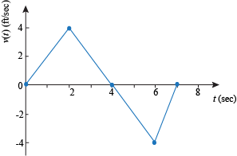
A cat starts at ground level and climbs a tree with velocity given by the graph below. When v(t) > 0 the cat is climbing upwards.
How high is the cat when t = 4? When t = 7?

Slide 35
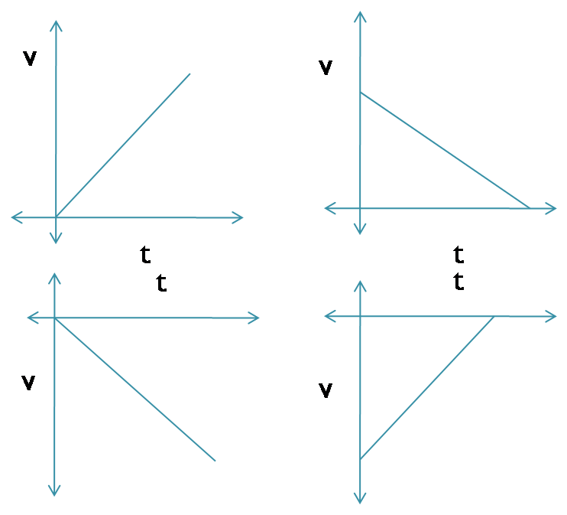
4. Among the following graphical representations, identify the ones pertaining to +ve velocity, -ve velocity, speeding up process and slowing down process.
5. What is an accelerated motion? What do you understand by the following terms:
Try to explain using some real time situation.
a. uniform velocity
b. constant acceleration
c. Positive acceleration
d. negative acceleration
e. deceleration

Slide 36
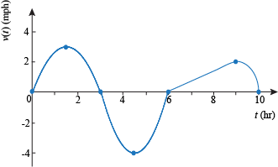
6. Brooke is strolling through the forest. Her velocity east is given by the following graph:
(a) At what time(s) is Brooke not moving? (b) On what time interval(s) is Brooke moving East? (c) On what time interval(s) is Brooke moving West? (d) At what time(s) is Brooke moving most rapidly East? (e) At what time(s) is Brooke moving most rapidly West? (f) At what time(s) is Brooke moving most rapidly? (g) On what time interval(s) is Brooke speeding up? (h) On what time interval(s) is Brooke slowing down?

Slide 37
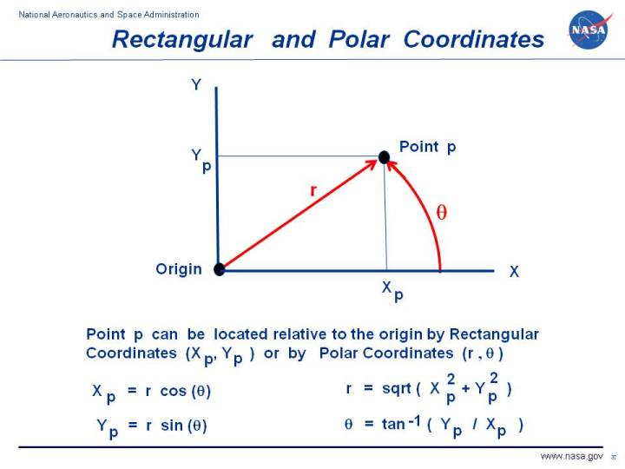
GENERALIZED COORDINATES
Generalized coordinates refers to the parameters that uniquely describe
the configuration of the system relative to some reference configuration
In two-dimensions the positions of a point can be specified either by its rectangular coordinates (x,y) or by its polar coordinates

Slide 38
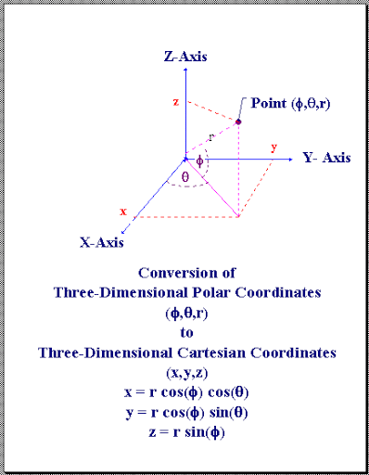
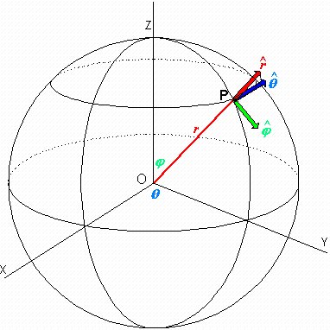
In three dimensions there are the options of rectangular coordinates (x,y,z) , or cylindrical coordinates ρ,ϕ,z or spherical coordinates r,θ,ϕ – or again there may be others that may be of use for specialized purposes (inclined coordinates in crystallography, for example)

Slide 39
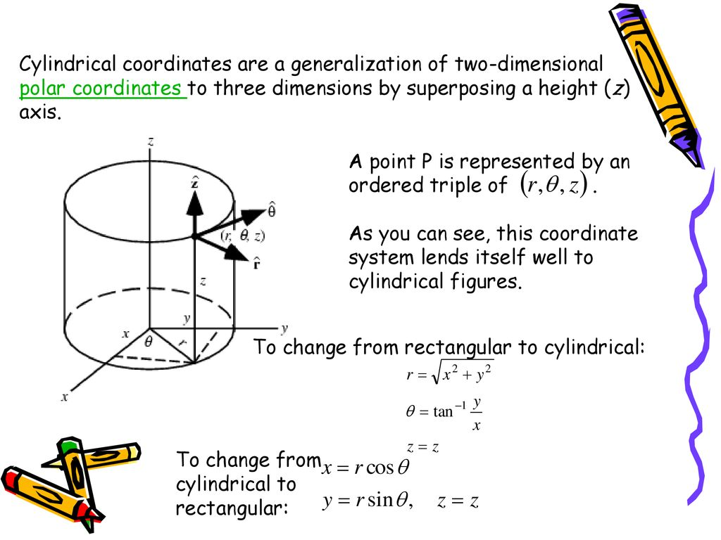

Slide 40
The state of a molecule might be described by a number of parameters,
such as the bond lengths and the angles between the bonds, and these
may be varying periodically with time as the molecule vibrates and twists, and these bonds lengths and bond angles constitute a set of coordinates which describe the molecule.
We are not going to think about any particular sort of coordinate system or set of coordinates.
Rather, we are going to think about generalized coordinates, which may be lengths or angles or various combinations of them. We shall call these coordinates ( q1,q2,q3,... ).
If we are thinking of a single particle in three-dimensional space, there will be three of them, which could be rectangular, or cylindrical, or spherical. If there were N particles, we would need 3N coordinates to describe the system – unless there were some constraints on the system.

Slide 41
With each generalized coordinate qj is associated a generalized force Pj , which is defined as follows. If the work required to increase the coordinate qj by δqj is Pjδqj , then Pj is the generalized force associated with the coordinate qj .
Reference:
https://phys.libretexts.org/Bookshelves/Classical_Mechanics/Book%3A_Classical_Mechanics_(Tatum)/13%3A_Lagrangian_Mechanics/13.02%3A_Generalized_Coordinates_and_Generalized_Forces
(Contributed by Jeremy Tatum, Emeritus Professor (Physics & Astronomy) at University of Victoria)

Slide 42
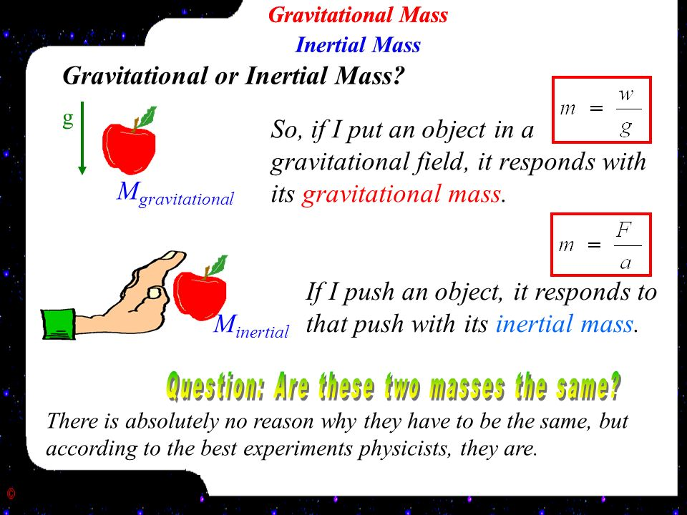
Inertial Mass

Slide 43
The mass of an object can generally be thought of as the quantity of matter it possesses. A rock, for example, has a certain mass—a fixed, unchanging quantity of matter.
However, a better way of defining it can be done using Newton’s second law of motion.
If a constant force is applied to an object on a frictionless, horizontal surface, the object accelerates—its velocity increases uniformly with time
If a force twice as large is applied to the same object, its acceleration doubles as well

Slide 44
The object’s acceleration is proportional to the force applied to it
However, the same force applied to a brick and a pebble will provide the brick with a much smaller acceleration than the pebble
If the proportionality constant is to reflect the difference between the brick and the pebble, then it should be a f(F, a). So m=f(F,a)
This constant ‘m’ is the inertial mass of the object
It shows that a brick requires a much greater force than a pebble to produce the same acceleration

Slide 45
Mass then can be defined as a ratio of force to acceleration.
We define one kilogram to be an inertial mass that accelerates at one meter per second per second when a force of one newton (1 N) is applied to it.
If the same force (one newton) is applied to a two kilogram mass, its acceleration is only 0.5 meter per second per second.
If two objects acquire the same acceleration when the same force is applied to them, they have the same inertial mass. It simply makes no difference even if the materials are different, their inertial masses are identical.

Slide 46
The mass of a body is its inertia or resistance to change of motion.
More precisely, it is a property of the body that determines the body's acceleration under the influence of a given force.
Mass can therefore be measured either by the amount of force necessary to impart to the body a given motion in a given time or by the acceleration produced by a given force.

Slide 47
Moment of Inertia:
Moment of inertia is the name given to rotational inertia, the rotational analog of mass for linear motion
It appears in the relationships for the dynamics of rotational motion.
The moment of inertia must be specified with respect to a chosen axis of rotation.
For a point mass, the moment of inertia is just the mass times the square of perpendicular distance to the rotation axis, I = mr².
This point mass relationship becomes the basis for all other moments of inertia since any object can be built up from a collection of point masses.

Slide 48
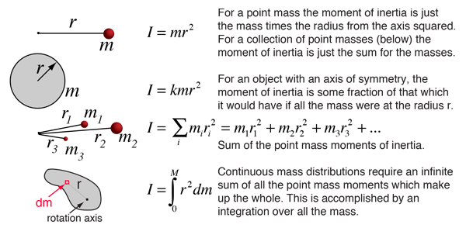

Slide 49
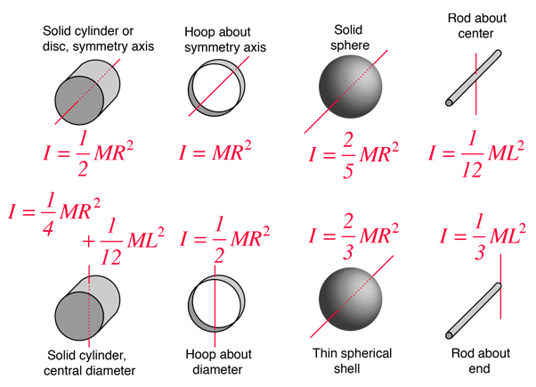

Slide 50
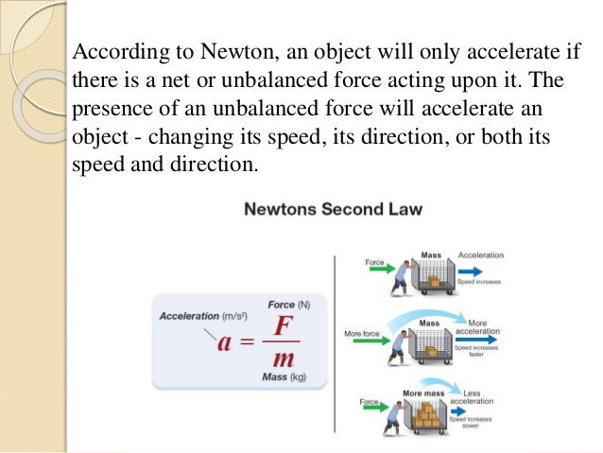
Force

Slide 51
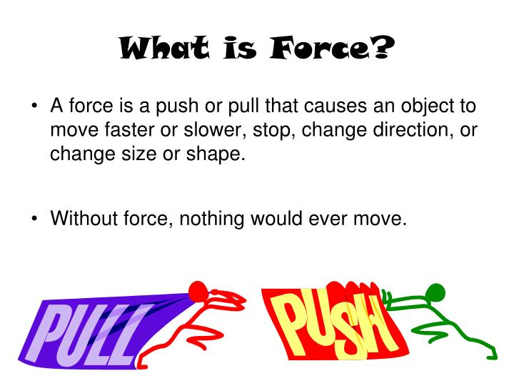

Slide 52
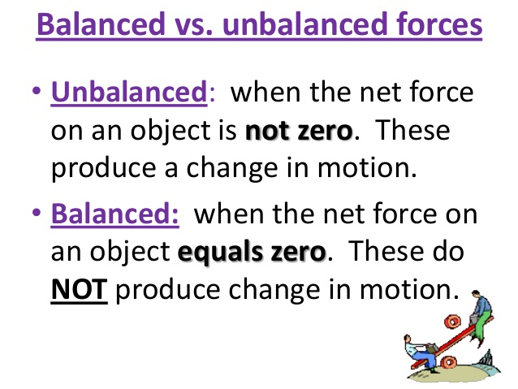

Slide 53
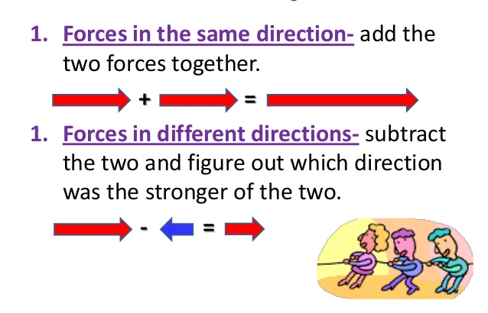

Slide 54
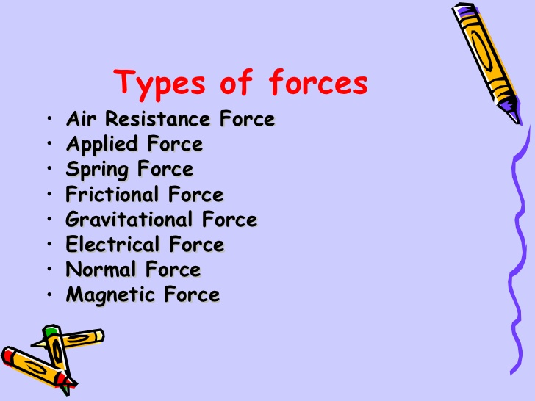

Slide 55
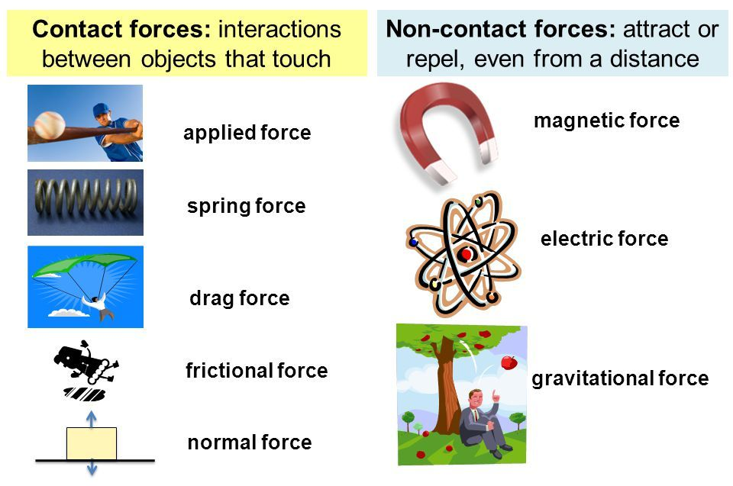

Slide 56
Torque
Torque is kind of like the rotational, twisty version of force: if we apply a net torque to something, it will have an angular acceleration, which means that its angular velocity will change.
Torque is a product of force and distance,
If we have a rigid rod of lenth r connected to an axle or pivot point on one end and apply a force F perpendicularly to the rod, we will get a torque of.

Slide 57
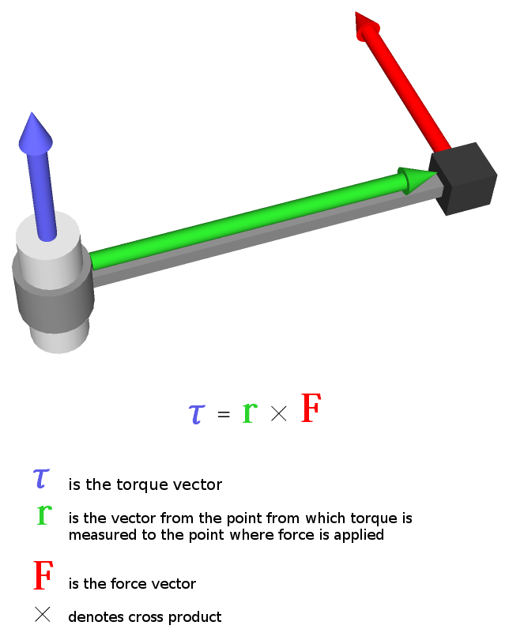

Slide 58
References:
Rindler, Wolfgang. Relativity: Special, General, and Cosmological. New York: Oxford University Press USA, 2006.
Serway, Raymond A. and Jerry S. Faughn. College Physics. vol. 1. Belmont, CA: Brooks Cole, 2005.
Touger, Jerold. Introductory Physics: Building Understanding. New York: John Wiley & Sons, 2006.
Robert Gardner, The Gale Encyclopedia of Science
http://hyperphysics.phy-astr.gsu.edu/hbase/mi.html#cmi
Pololu%20-%20Force%20and%20torque.html

